Slide 1
Pointers

Slide 2
Topics
Pointers
  Memory addresses
  Declaration
  Dereferencing a pointer
  Pointers to pointer

Slide 3
Computer Memory
Each variable is assigned a memory slot (the size depends on the data type) and the variable’s data is stored there
Memory address:
1020
1024
1032
…
…
100
…
1024
…
a
Variable a’s value, i.e., 100, is
stored at memory location 1024
int a = 100;

Slide 4
Pointers
A pointer is a variable used to store the address of a memory cell.
We can use the pointer to reference this memory cell
Memory address:
1020
1024
1032
…
…
100
…
1024
…
integer
pointer

Slide 5
Pointer Types
Pointer
  C++ has pointer types for each type of object
    Pointers to int objects
    Pointers to char objects
    Pointers to user-defined objects
    (e.g., RationalNumber)
  Even pointers to pointers
    Pointers to pointers to int objects

Slide 6
Pointer Variable
Declaration of Pointer variables
  type* pointer_name;
  //or
  type *pointer_name;
  where type is the type of data pointed to (e.g. int, char, double)
  Examples:
  int *n;
  RationalNumber *r;
  int **p; // pointer to pointer

Slide 7
Address Operator &
The "address of " operator (&) gives the memory address of the variable
  Usage: &variable_name
Memory address:
1020
1024
…
…
100
…
…
…
a
int a = 100;
//get the value,
cout << a; //prints 100
//get the memory address
cout << &a; //prints 1024

Slide 8
Address Operator &
Memory address:
1020
1024
1032
…
88
100
…
…
…
a
b
#include <iostream>
using namespace std;
void main(){
int a, b;
a = 88;
b = 100;
cout << "The address of a is: " << &a << endl;
cout << "The address of b is: " << &b << endl;
}
Result is:
The address of a is: 1020
The address of b is: 1024

Slide 9
Pointer Variables
The value of pointer p is the address of variable a
A pointer is also a variable, so it has its own memory address
Memory address:
1020
1024
1032
…
88
100
…
1024
…
a
p
int a = 100;
int *p = &a;
cout << a << " " << &a <<endl;
cout << p << " " << &p <<endl;
Result is:
100 1024
1024 1032

Slide 10

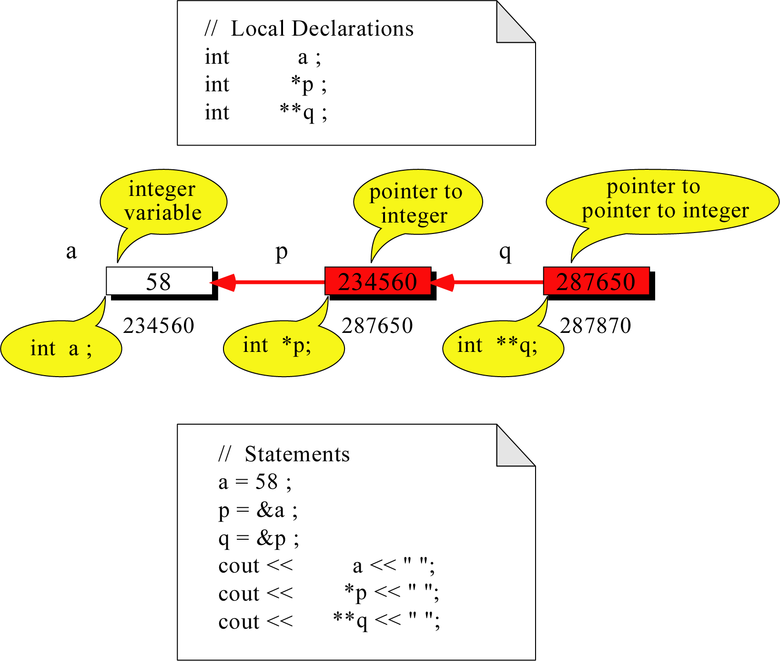
Pointer to Pointer
What is the output?
58 58 58

Slide 11
Dereferencing Operator *
We can access to the value stored in the variable pointed to by using the dereferencing operator (*),
Memory address:
1020
1024
1032
…
88
100
…
1024
…
a
p
int a = 100;
int *p = &a;
cout << a << endl;
cout << &a << endl;
cout << p << " " << *p << endl;
cout << &p << endl;
Result is:
100
1024
1024 100
1032

Slide 12
Don’t get confused
Declaring a pointer means only that it is a pointer: int *p;
Don’t be confused with the dereferencing operator, which is also written with an asterisk (*). They are simply two different tasks represented with the same sign
int a = 100, b = 88, c = 8;
int *p1 = &a, *p2, *p3 = &c;
p2 = &b; // p2 points to b
p2 = p1; // p2 points to a
b = *p3; //assign c to b
*p2 = *p3; //assign c to a
cout << a << b << c;
Result is:
888

Slide 13
A Pointer Example
Memory Layout
The code
void doubleIt(int x,
int * p)
{
*p = 2 * x;
}
int main(int argc, const char * argv[])
{
int a = 16;
doubleIt(9, &a);
return 0;
}
Box diagram
main
16
p
(8200)
8192
a
doubleIt
x
(8196)
9
a
(8192)
16
main
doubleIt
x
9
a gets 18
p
Notes:
Note the signature of main() – it’s an array parameter. And, like other examples we’ve given, it takes the number of elements as a parameter. Why?

Slide 14
Another Pointer Example
Let’s figure out:
value1==? / value2==?
Also, p1=? p2=?
#include <iostream>
using namespace std;
int main (){
int value1 = 5, value2 = 15;
int *p1, *p2;
p1 = &value1; // p1 = address of value1
p2 = &value2; // p2 = address of value2
*p1 = 10; // value pointed to by p1=10
*p2 = *p1; // value pointed to by p2= value // pointed to by p1
p1 = p2; // p1 = p2 (pointer value copied)
*p1 = 20; // value pointed to by p1 = 20
cout << "value1==" << value1 << "/ value2==" << value2;
return 0;
}

Slide 15
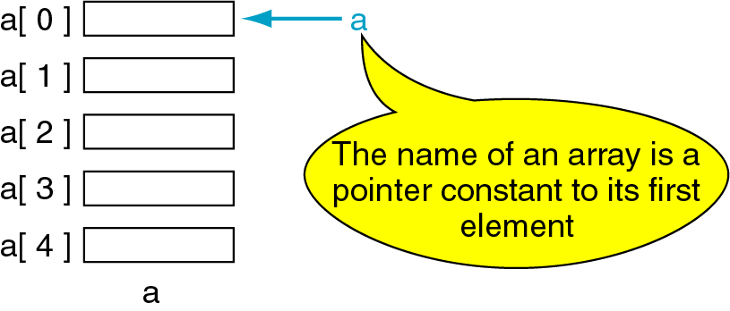
Pointers and Arrays
The name of an array points only to the first element not the whole array.
1000
1004
1008
1012
1016

Slide 16
Array Name is a pointer constant
#include <iostream>
using namespace std;
void main (){
int a[5];
cout << "Address of a[0]: " << &a[0] << endl
<< "Name as pointer: " << a << endl;
}
Result:
Address of a[0]: 0x0065FDE4
Name as pointer: 0x0065FDE4

Slide 17
Dereferencing An Array Name
This element is called a[0] or *a
#include <iostream>
using namespace std;
void main(){
int a[5] = {2,4,6,8,22};
cout << *a << " "
<< a[0];
} //main
a[0]
2
a
a[1]
4
a[2]
6
a[3]
8
a[4]
22
a

Slide 18
Pointer Arithmetic
Given a pointer p, p+n refers to the element that is offset from p by n positions.
a
2
p - 1
4
p
a + 1
a + 2
6
p + 1
a + 3
8
p + 2
a + 4
22
p + 3

Slide 19
Dereferencing Array Pointers
a[0] or *(a + 0)
2
a
a[1] or *(a + 1)
4
a + 1
a[2] or *(a + 2)
6
a + 2
a[3] or *(a + 3)
8
a + 3
a[4] or *(a + 4)
22
a + 4
*(a+n) is identical to a[n]
Note: flexible pointer syntax

Slide 20
Array of Pointers & Pointers to Array
a
p
b
c
An array of Pointers
A pointer to an array
int a = 1, b = 2, c = 3;
int *p[5];
p[0] = &a;
p[1] = &b;
p[2] = &c;
int list[5] = {9, 8, 7, 6, 5};
int *p;
P = list;//points to 1st entry
P = &list[0];//points to 1st entry
P = &list[1];//points to 2nd entry
P = list + 1; //points to 2nd entry

Slide 21
Example 1:
#include <iostream>
using namespace std;
int main()
{
int arr[5] = {1, 2, 3, 4, 5};
int *ptr = &arr[0];
cout<<“array elements are”;
for(int i = 0; i < 5; i++)
{
cout<< *ptr <<" "; // cout<<*(p+i);
ptr++;
}
return 0;
}

Slide 22
Example 2
#include <iostream.h>
int main()
{
int arr[]={31, 54, 77, 52, 93};
int *ptr, sum=0;
ptr = arr; //points to array
for(int j=0; j<5; j++)
{
sum = sum + *ptr;
ptr++;
}
cout << sum;
return 0;
}

Slide 23
#include <iostream>
using namespace std;
int sum(int *ptr,int n)
{
int i,s1=0;
for(i=0;i<n;i++){
s1+=*ptr;
ptr++;
}
return s1;
}
int main()
{
int n,a[10],*p,s;
cout<<"enter n value"; cin>>n;
cout << "Enter elements: ";
for(int i = 0; i < n; i++){
cin >> a[i];
}
p=&a[0];
s=sum(p,n);
cout<<"sum of elements "<<s;
return 0;
}

Slide 24
Dynamic Memory Allocation

Slide 25
What is Memory Management?
Memory management is a process of managing computer memory, assigning the memory space to the programs to improve the overall system performance.
Why is memory management required?
As we know that arrays store the homogeneous data, so most of the time, memory is allocated to the array at the declaration time. Sometimes the situation arises when the exact memory is not determined until runtime. To avoid such a situation, we declare an array with a maximum size, but some memory will be unused. To avoid the wastage of memory, we use the new operator to allocate the memory dynamically at the run time.

Slide 26
Memory Management Operators
new operator:
The new operator denotes a request for memory allocation on the Heap. If sufficient memory is available, new operator initializes the memory and returns the address of the newly allocated and initialized memory to the pointer variable.
Syntax to use new operator: To allocate memory of any data type, the pointer-variable = new data-type;
  ptr = new data-type [ size ];
delete operator
Since it is programmer’s responsibility to deallocate dynamically allocated memory, programmers are provided delete operator by C++ language.
Syntax:
delete pointer-variable;
delete[] ptr;

Slide 27
Example 1:
#include <iostream>
using namespace std;
int main()
{
int* pointInt;
float* pointFloat;
pointInt = new int;
pointFloat = new float;
*pointInt = 45;
*pointFloat = 45.45;
cout << *pointInt << endl;
cout << *pointFloat << endl;
delete pointInt;
delete pointFloat;
return 0;
}

Slide 28
Example 2:
#include <iostream>
using namespace std;
int main()
{
int num;
cout << "Enter total number of students: “; cin >> num;
float* ptr;
ptr = new float[num];
cout << "Enter GPA of students." << endl;
for (int i = 0; i < num; ++i) {
cin >> *(ptr + i);
}
cout << "\nDisplaying GPA of students." << endl;
for (int i = 0; i < num; ++i) {
cout << *(ptr + i) << endl;
}
delete [] ptr; // ptr memory is released
return 0;
}

